Slide 2
HK.SHOP.COM
美安香港的使命
是徹底改革顧客網上選購
產品及服務的方式
Market Hong Kong’s mission is to revolutionize the way consumers shop for products and services online.

Slide 3
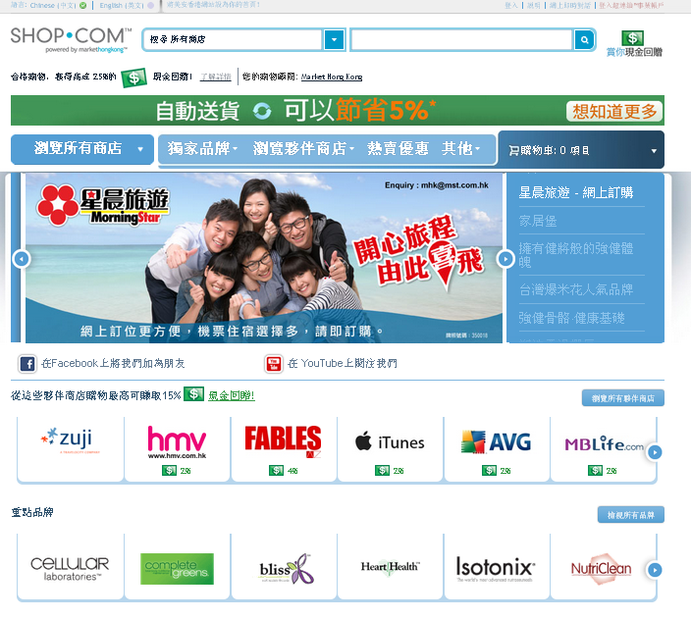
你入門網站的優勢 Benefits of Your Portal
用簡易方式讓你及你的顧客購買美安香港獨家品牌產品
為你及你的顧客提供過千間夥伴商店
快捷、準確的產品及內容搜尋
熱賣優惠
加上為你及你顧客的合格消費提供現金回贈/IBV計劃
Easy way for your consumers to purchase mhk Brand products
Offers thousand of partner stores for you and your customers.
Quick, Accurate Product & Content Search
Hot Deals
Plus offers you & your customers a cashback / IBV program for qualified purchases.

Slide 4
為甚麼你需要入門網站？ Why do you need a portal?

Slide 5
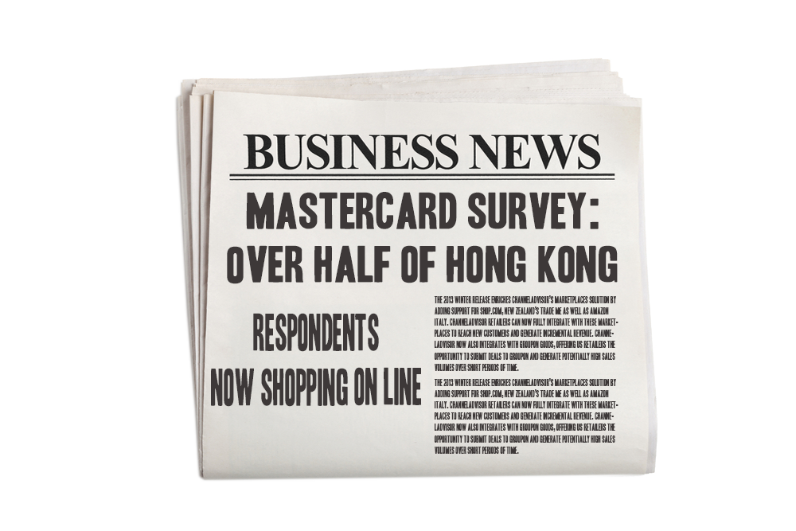
網上購物 Online Shopping
財經消息
MasterCard 調查：
超過一半香港受訪者
透過互聯網購物

Slide 6
MasterCard 調查 MasterCard Survey
超過一半香港受訪者透過互聯網購物
58%受訪者透過互聯網消費
Over Half of Hong Kong Respondents Now Shopping Online.
58% of people use the Internet to make purchases.

Slide 7
MasterCard 調查 MasterCard Survey
在過去三個月內曾經上網購物的香港受訪者當中，他們平均購買產品的次數亦上升，由2010年的4.3次增至2011年的4.8次。網上購物繼續以女性消費者較多（62%為女性對比54%男性）。整體來說，18至24歲（57%）及25至34歲（62%）的消費者較多利用互聯網購物。
The average number of purchases made by those who have shopped online in Hong Kong in the past three months has also increased, rising from 4.3 in 2010 to 4.8 in 2011. Women continue to lead the way in online shopping (62% of women vs. 54% of men), while more broadly those aged 18-24 (57%) and 25-34 (62%) are more likely to access the Internet to buy online.

Slide 8
MasterCard 調查 MasterCard Survey
另外，18%港人計劃於未來六個月以手機上網購物，主要由於手機應用程式的普及與便捷，令手機購物變得更為容易。電影戲票（24%）、優惠券（22%）及玩具／禮物（19%）為三項最常購買的商品類別。
A further 18% of Hongkongers plan on making a purchase in the next six months. This has been driven primarily by the added convenience and the proliferation of apps which makes it easier to shop using mobile phones, with cinema tickets (24%), coupon deals (22%) and toys/gifts (19%) making up the top three purchase categories.

Slide 9
MasterCard 調查 MasterCard Survey
此調查為一項評估消費者網上購物傾向的指標，調查由 2011年12月5日至2012年2月6日於25個市場進行。亞太區的報告共訪問了7,373名來自14個亞太區市場的消費者有關他們網上購物的習慣。
The survey, which serves as a benchmark that measures consumers’ propensity to shop online, was conducted across 25 markets between 5 December 2011 and 6 February 2012. The report for the Asia/ Pacific1region included interviews with 7,373 respondents from 14 markets who were asked questions about their online shopping habits.

Slide 10
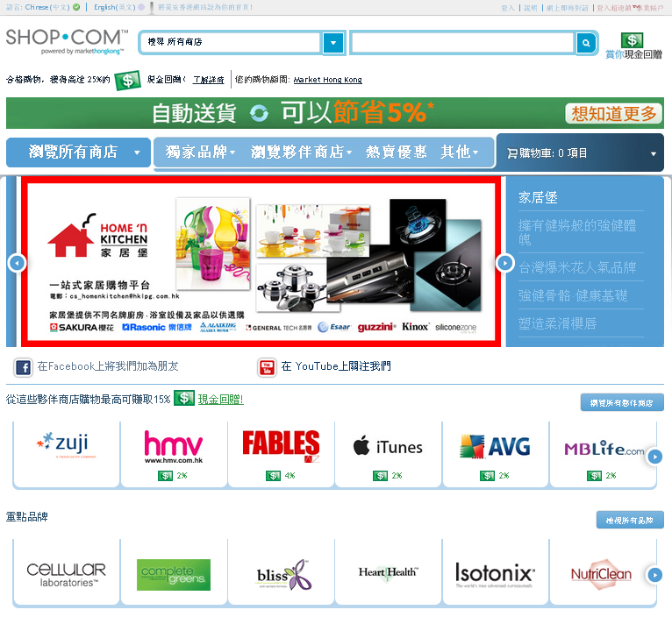

Slide 11
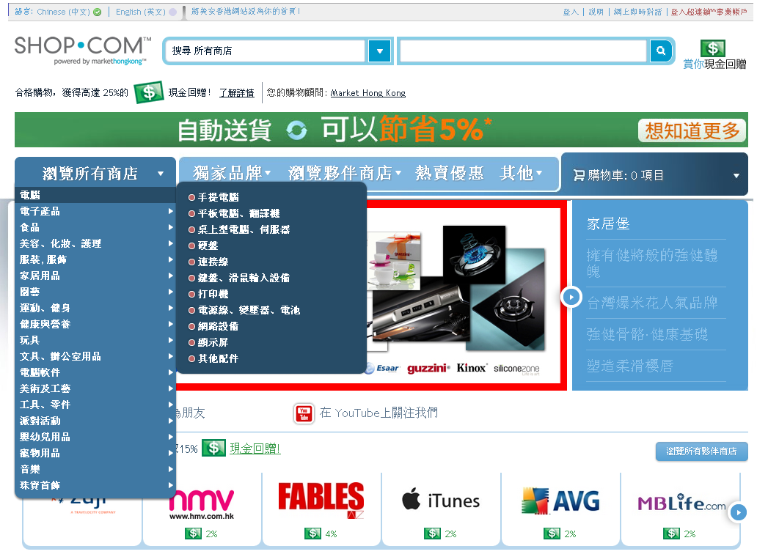

Slide 12
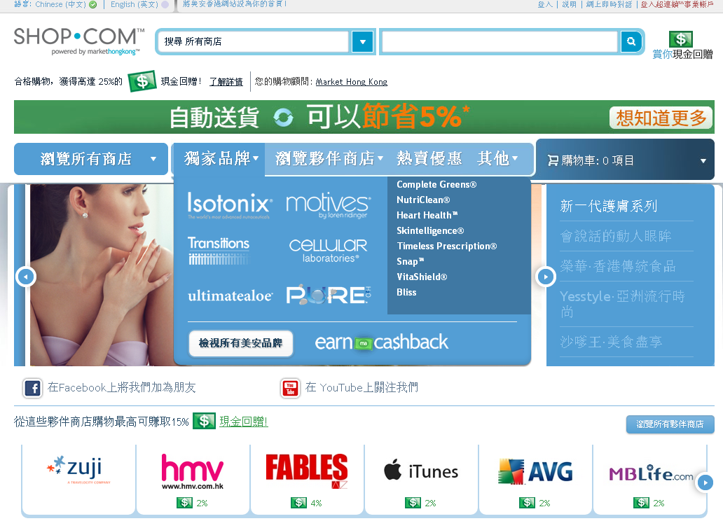

Slide 13
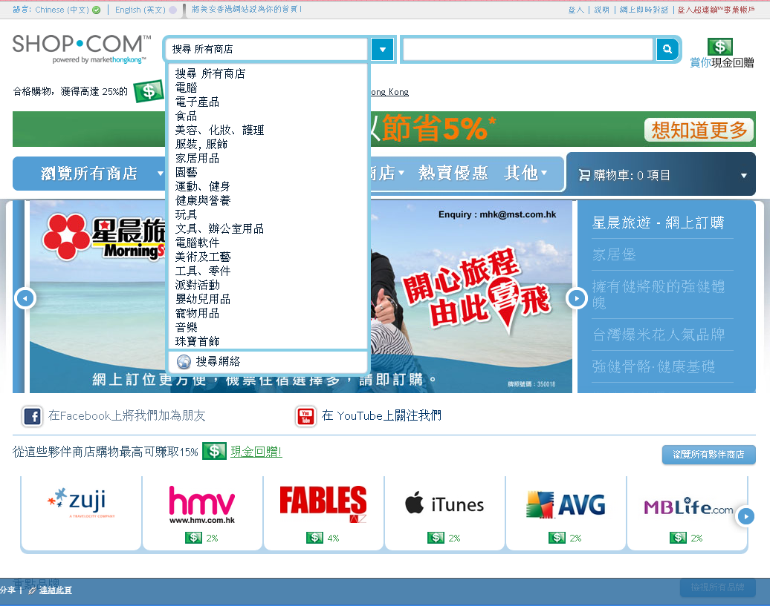
isotonix

Slide 15
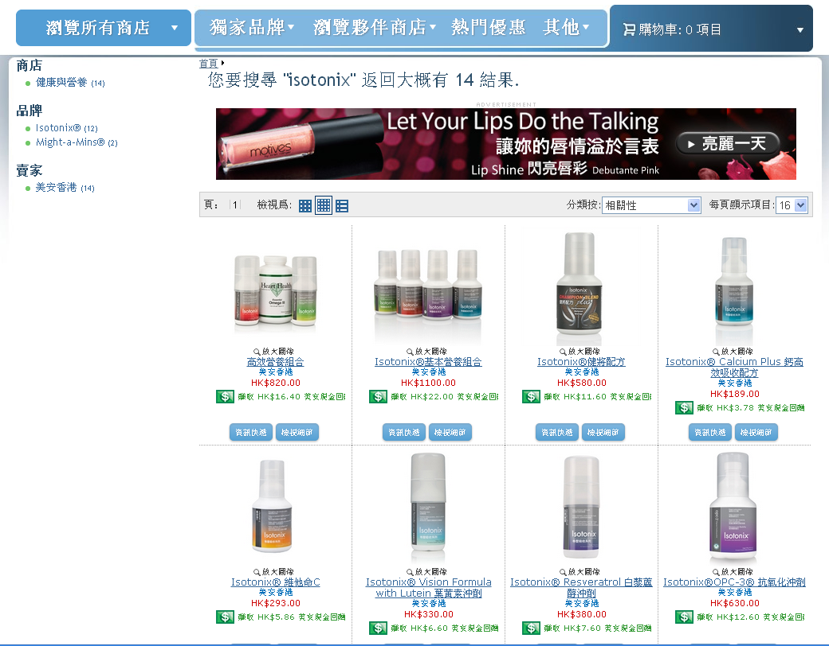

Slide 16
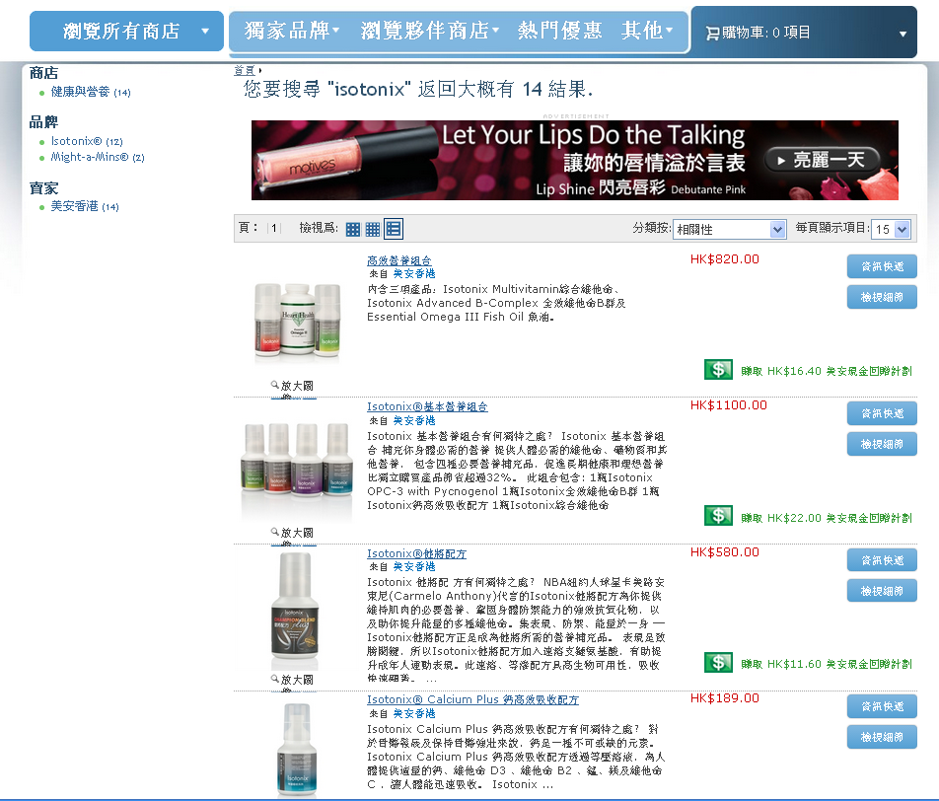

Slide 17
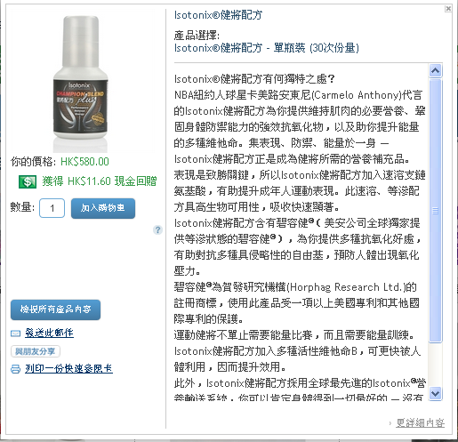

Slide 18
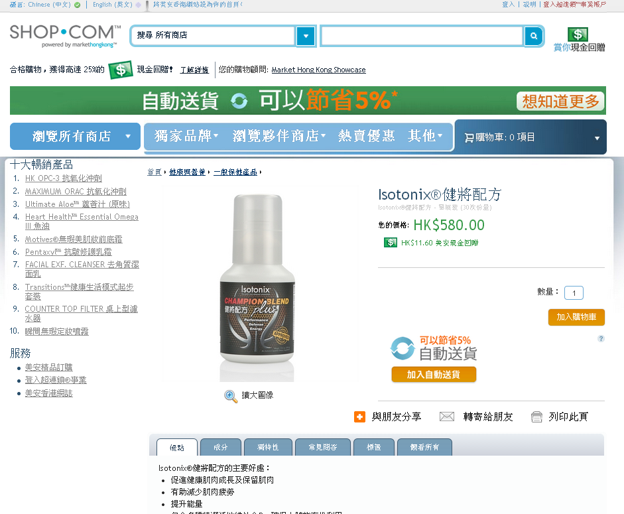
可於超過300個
社交媒體網站分享，如:
Share on over 300+ Social Media sites like:

Slide 19
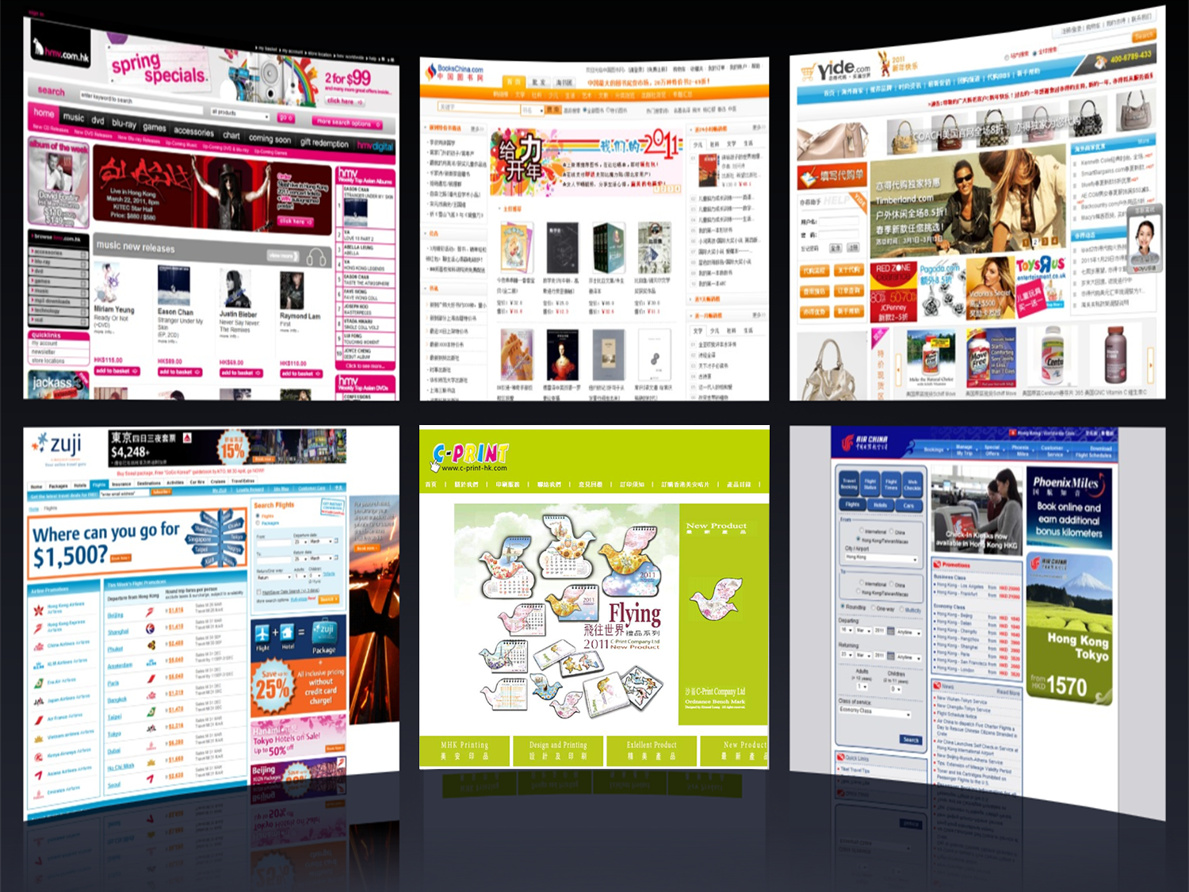
夥伴商店 Partner Stores

Slide 20
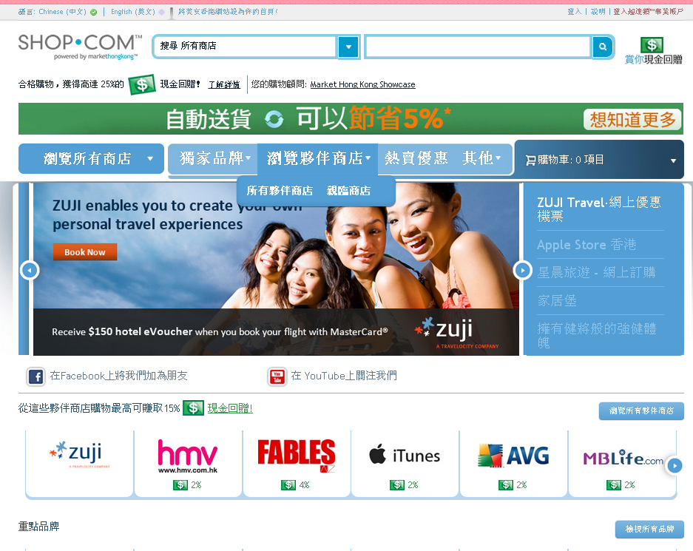
選擇網上商店或
店內提貨
Choose from either
the Online Stores or even the In Store Pickup

Slide 21
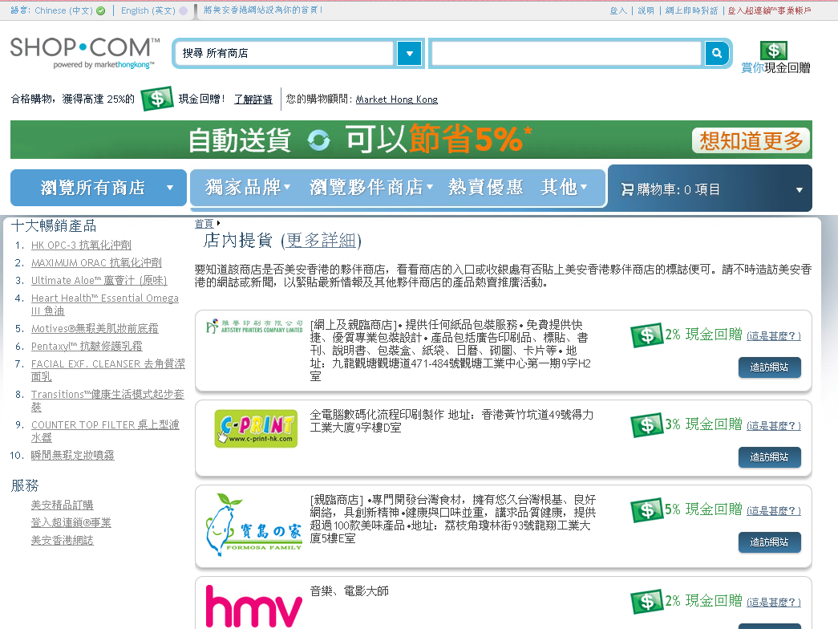

Slide 22
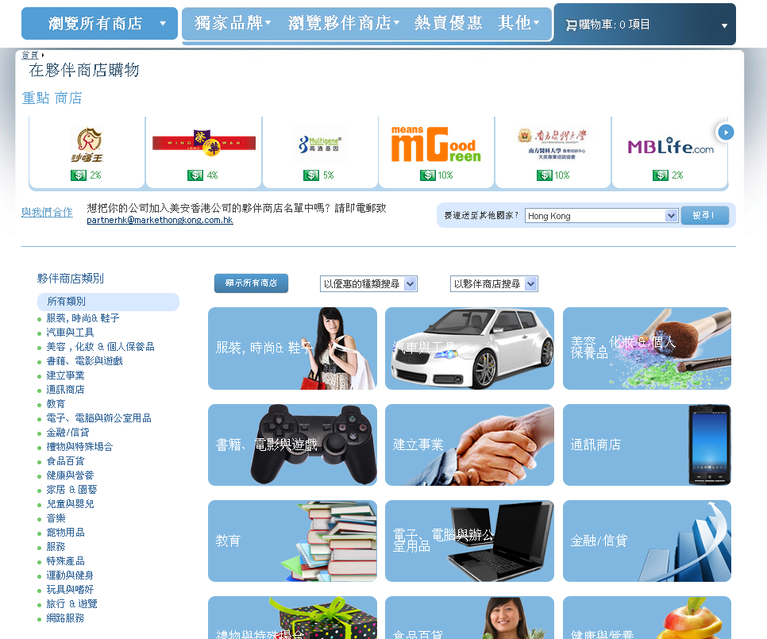

Slide 23
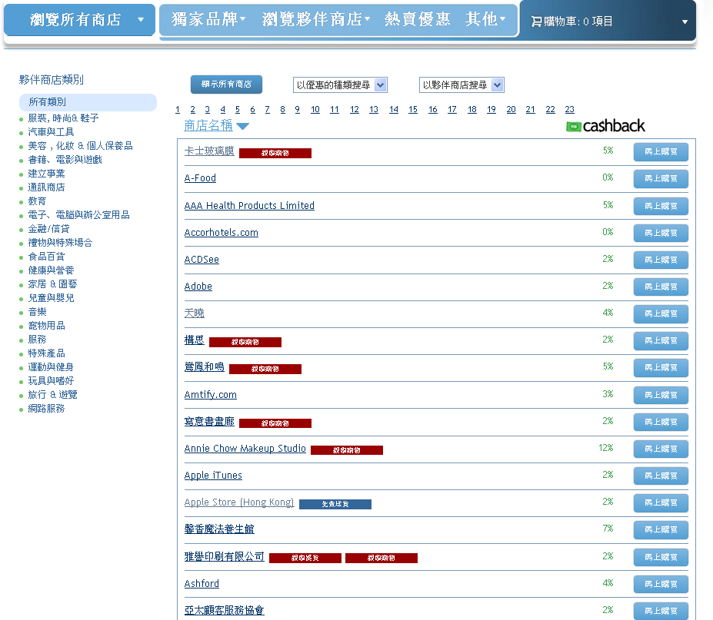

Slide 24
夥伴商店 Partner Stores
超過1,100間夥伴商店讓你購物
超過1,000間夥伴商店提供2%以上現金回贈
超過190間親臨夥伴商店讓你賺取現金回贈及IBV
Over 1,100+ partners to shop from
Over 1,000 partners greater than 2% Cashback
Over 190+ Walk-In Stores that you can earn Cashback and IBV from.

Slide 25
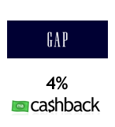
夥伴商店 Partner Stores
3%
3%
3%
2%
3%
2%
4%
10%
7%

Slide 28
瑪姬美容集團
Beauty Maggie
專業美容服務
一站式美容護理中心
Privilege Beauty Experience
One Stop Skin care & Beauty centre
IBV/現金回贈 Cashback:
8% IBV 7% 現金回贈 Cashback
親臨夥伴商店
Walk-In Partner
Shop Alert!

Slide 29
沙嗲王 Satay King
著名東南亞菜式
全線分店可享現金回贈
Popular South-east Asian cuisine; Cashback available at All Branches!
IBV/現金回贈 Cashback:
5% IBV 2% 現金回贈 Cashback
親臨夥伴商店
Walk-In Partner
Shop Alert!

Slide 30
榮華
Wing Wah
傳統餅店，已有60年歷史
著名食品有臘腸、蛋卷、粽
Traditional cake shop of 60 years. Preserved meat sausage, egg roll, rice dumplings.
IBV/現金回贈 Cashback:
4% IBV 4% 現金回贈 Cashback
即時現金回贈優惠和IBV
Instant Savings & IBV
Shop Alert!

Slide 31
家居堡有限公司 Home N Kitchen Limited
提供一站式家居購物平台及完善售後服務，多個名牌廚電、氣體爐具、家居產品的香港總經銷。
Aim is to provide comprehensive and high-quality one-stop and after-sale services specializing in professional kitchen design and kitchen cabinet mix. Sole agent for a number of kitchen systems and products in Hong Kong.
IBV/現金回贈 Cashback:
5% IBV 10% 現金回贈 Cashback
網上及親臨
夥伴商店
Online &
Walk-In Partner
Shop Alert!

Slide 32
ElectriCity.com.hk
沙田電業於1991年成立• 提供電器產品，種類繁多，應有盡有。無論是家居電器還是日常的小型電子產品如耳機、收音機、播放器、微波爐及電視機等均有售賣
Shatin Electric was established at 1991. Carries famous local and international branded household and small appliances. Products includes TV, Microwave oven, head-set, radio set, player, etc.
IBV/現金回贈 Cashback:
5% IBV 2% 現金回贈 Cashback
網上夥伴商店
Online Partner
Shop Alert!

Slide 33
網上旅遊預訂引擎，可訂購所有機票及酒店套票
每月特別優惠套票！
Online Travel Booking engine. Book all your airline tickets and hotel packages through Zuji
Monthly special discounted packages available!
IBV/現金回贈 Cashback:
3% IBV
網上夥伴商店 Online
Partner
每月都會推出特別優惠套票！
Monthly special discounted packages available!
Shop Alert!

Slide 34
星晨旅遊
Morning Star Travel
本港極具規模的連鎖旅行社提供多元化的優質旅遊產品
網上訂購
酒店
機票+酒店套餐及
酒店+旅遊套餐
A large-scale chain travel agency
Extensive experience in organizing tours
Provides online booking services of
Hotel
flight + hotel package and
hotel + tour package
IBV/現金回贈 Cashback:
2% IBV
網上夥伴商店 Online
Partner
每月都會推出特別優惠套票！
Monthly special discounted packages available!
Shop Alert!

Slide 35
光明視光中心 Brighter Optical Center
開業逾40年
匯集國際高科技視光儀器
為眼睛健康提供更快捷、更全面的診斷服務
Has been operated for over 40 years. Utilizes international advanced optometric instruments to offer more efficient and comprehensive examination.
IBV/現金回贈 Cashback:
4% IBV 2% 現金回贈 Cashback
親臨夥伴商店
Walk-In Partner
與著名視力保健護理產品品牌CIBAVision合作推出特別優惠！
Special promotion available!
Shop Alert!

Slide 37
主題性宣傳活動 入門網站頁面 Seasonal Promotion Campaign Webportal page

Slide 38
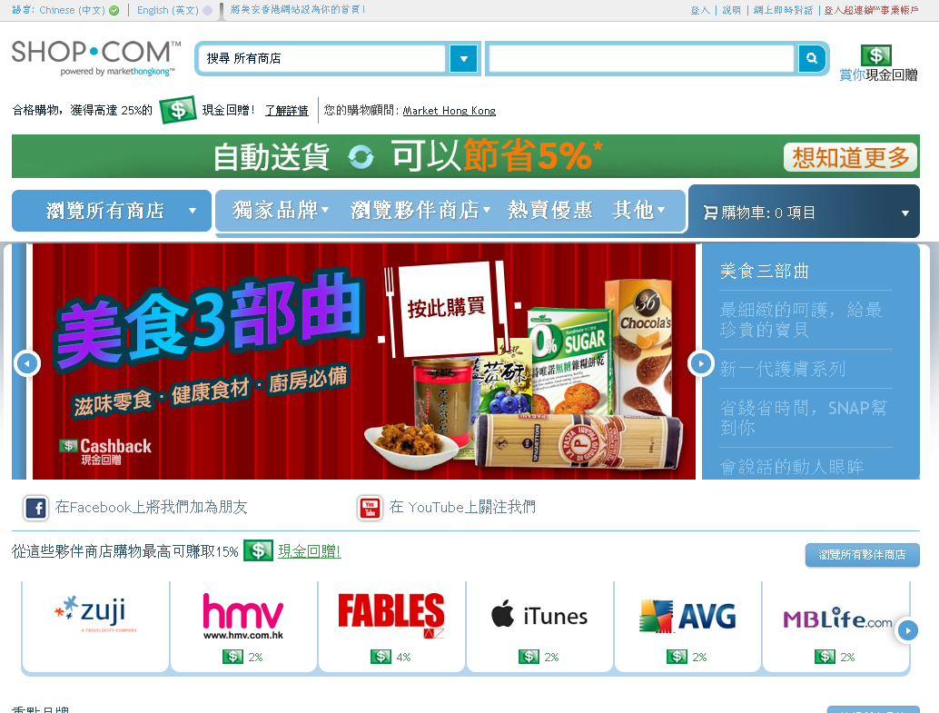

Slide 39
優惠顧客收到宣傳電郵 Promotion Email for Preferred Customer

Slide 41
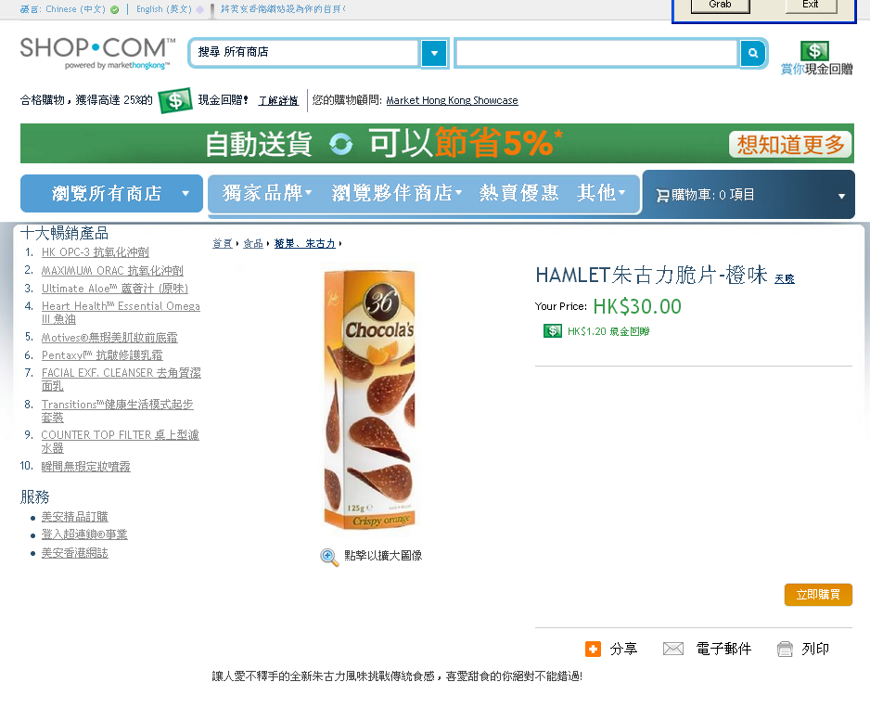

Slide 42
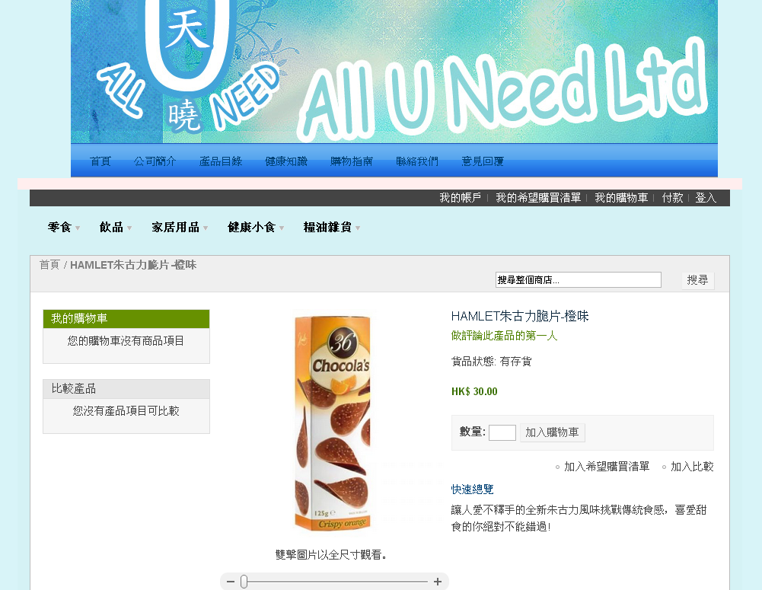

Slide 43
卓越表現夥伴商店 Top Performing Partner Stores

Slide 44
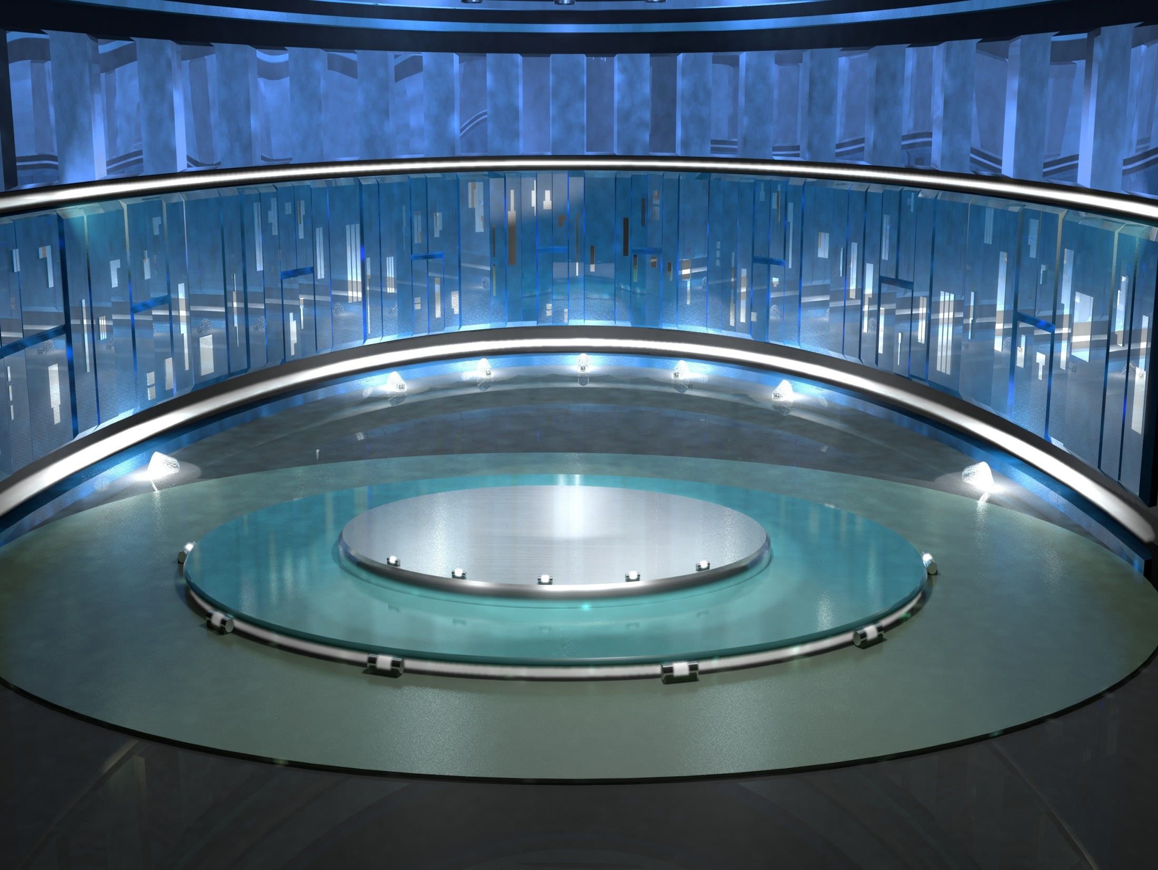
Animated or Static?
星晨旅遊
Morning Star Travel
2% IBV
共付 Paid out:
超過 Over 1,900 IBV

Slide 45
Animated or Static?
沙嗲王
Satay King
5% IBV
2% Cashback
共付 Paid out:
超過 Over 1,900 IBV
超過 Over $10,000 現金回贈 in Cashback

Slide 46
Animated or Static?
寶島之家
Formosa Family
5% IBV
5% Cashback
共付 Paid out:
超過 Over 1,900 IBV
超過 Over $50,000 現金回贈 in Cashback
共付 Paid out:
超過 Over 2,500 IBV
超過 Over $19,000 現金回贈 in Cashback

Slide 47
熱賣優惠

Slide 48
熱賣優惠和推廣 Hot Deals & Promotions
美安香港和夥伴商店的熱賣優惠已成為搜尋折扣和優惠的最佳熱點
Hot Deals has become the best place to find any special promotion or offer for any Market Hong Kong Product and a Partner Store

Slide 49
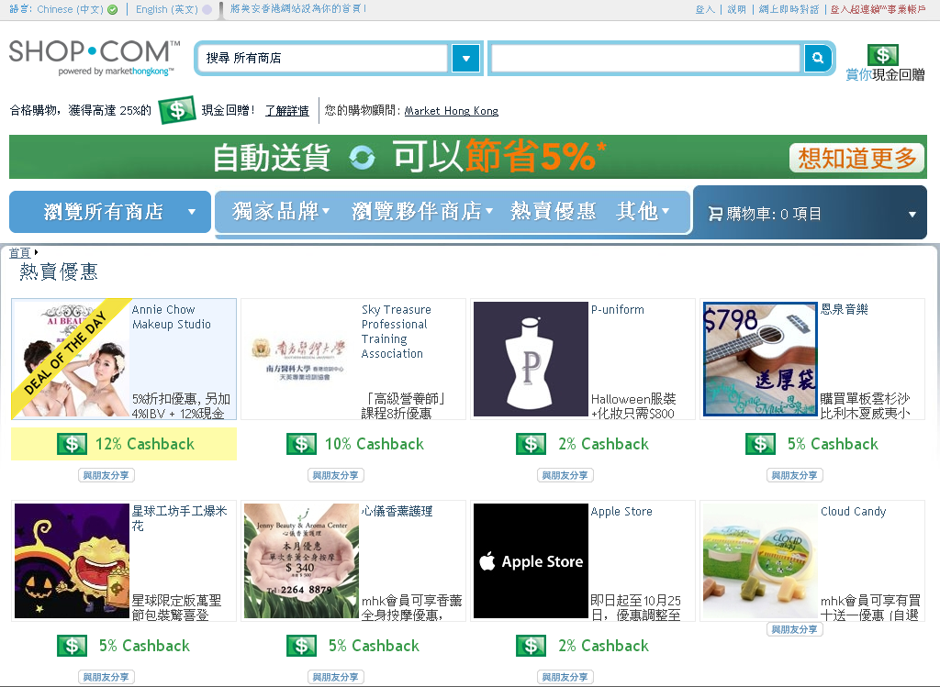

Slide 50
邀請朋友工具 Invite Friends Tool

Slide 51
於不同平台邀請朋友
Invite Friends From:

Slide 52
加入選定聯絡人

Slide 54
當你的朋友點擊「立即註冊」，就會自動連結至你入門網站的簡易註冊程序。
Now when your friend clicks “Sign Up Now”, they will be automatically EZ-Registered on your Portal.
Notes:
Replace with Taiwan Email

Slide 55
優惠顧客自動送貨計劃 Preferred Customer Autoship

Slide 57
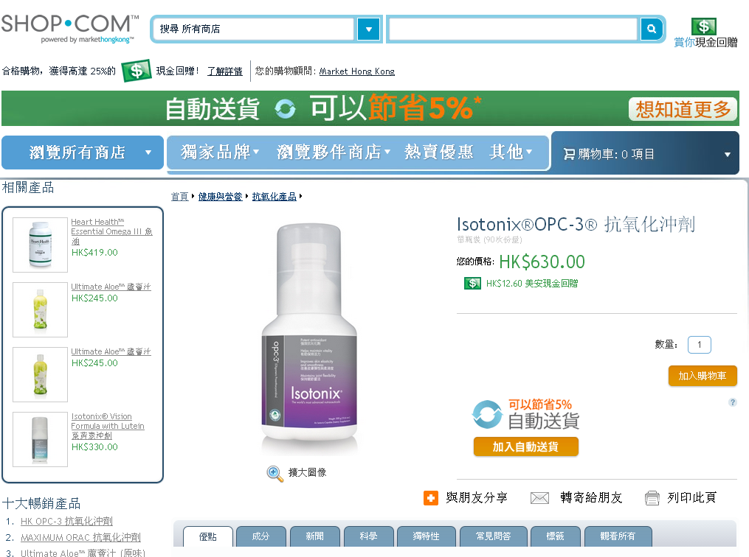
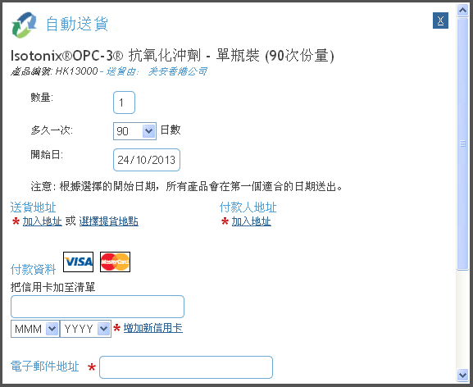
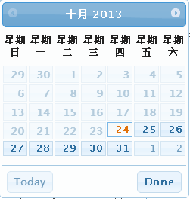

Slide 58
motives.com.hk

Slide 59
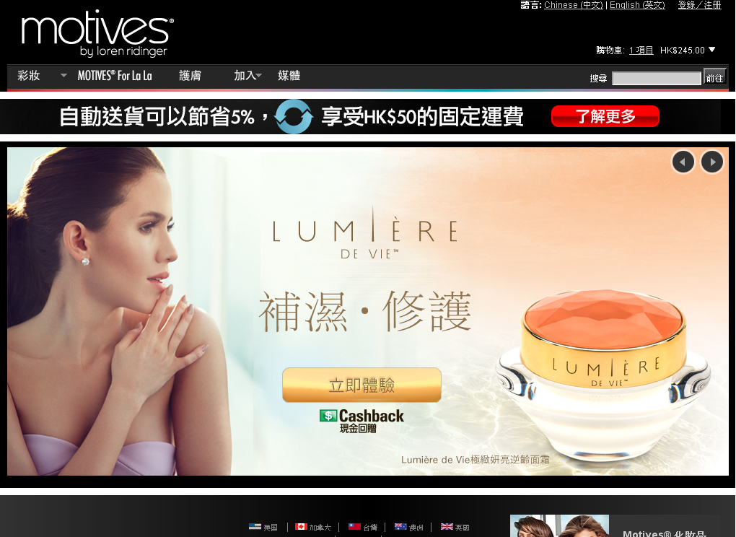

Slide 60
Motives.com.hk
香港的活躍獨立購物顧問可免費使用Motives.com.hk！
Motives.com.hk支援電子商務，包含互動的網站廣告橫額、詳盡的產品資訊，以及「立即加入」等建立事業元素，讓你一次過獲得所有必備美容產品！
Motives.com.hk is FREE to all active Independent Shop Consultants within Hong Kong!
Motives.com.hk is e-commerce-enabled and has features such as interactive web banners, detailed product information, business-building elements, such as “Join Now” and much more. Get all your beauty must-have products in one place!

Slide 61
Motives.com.hk
獨立購物顧問可透過超連鎖事業帳戶進入Motives.com.hk網站。我們已自動為你設定網站，訪客可透過你HK.SHOP.COM的相同名稱瀏覽Motives.com.hk網站。
你的Motives彩妝網址
motives.com.hk/your_portal_name
Independent Shop Consultants can find access to their Motives.com.hk website within their UnFranchise Business Account. The site has been automatically set up for you and is live to the public using the same address as your HK.SHOP.COM website.
Your new motives address: motives.com.hk/your_portal_name

Slide 64
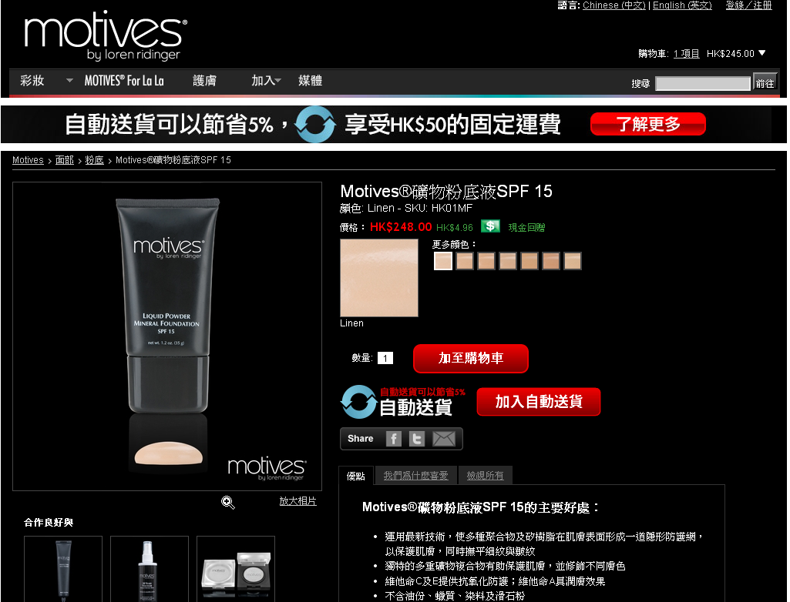

Slide 67
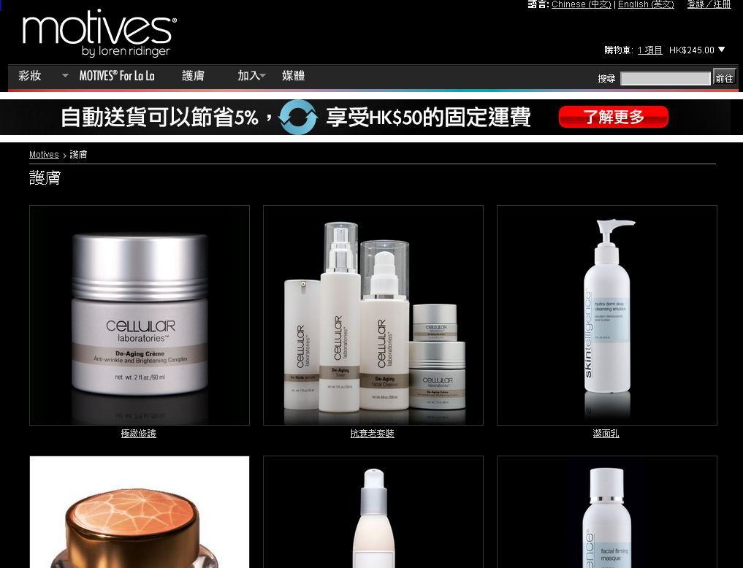

Slide 68
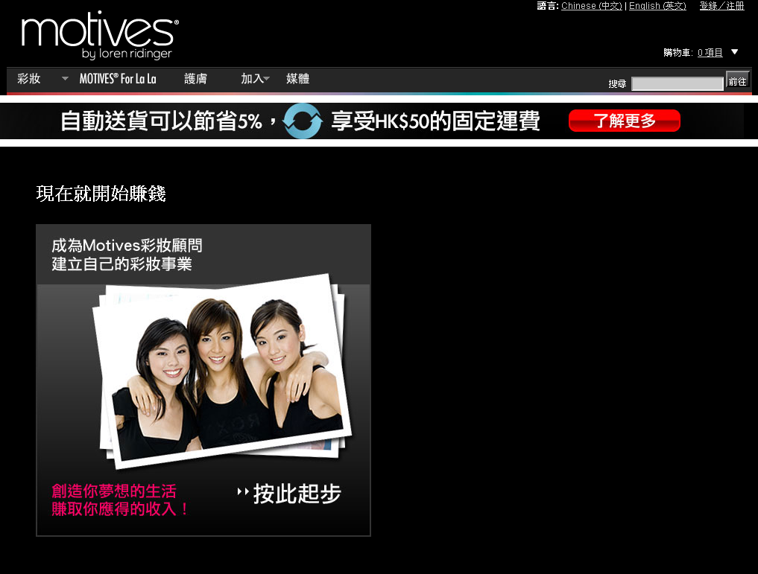

Slide 70
.
Notes:
70

